Slide 1


Abhishek Mishra
© All rights reserved by Fireblaze Technologies Pvt. Ltd.

Slide 2
Problem Statement
According to the given dataset of spotify, it is to be studied that which genre is used by most people, whose popularity is more, which artist's track is more popular, how many minutes which track is played.
© All rights reserved by Fireblaze Technologies Pvt. Ltd.

Slide 3
Proposed Solution
Spotify is an on-demand music streaming service that allows users to browse through a list of music, licensed through multiple record labels, and create and share playlists with other users
© All rights reserved by Fireblaze Technologies Pvt. Ltd.

Slide 4
Methodology
The python libraries are used :
Numpy
Pandas
Seaborn
Matplotlib
Pyplot
© All rights reserved by Fireblaze Technologies Pvt. Ltd.

Slide 5
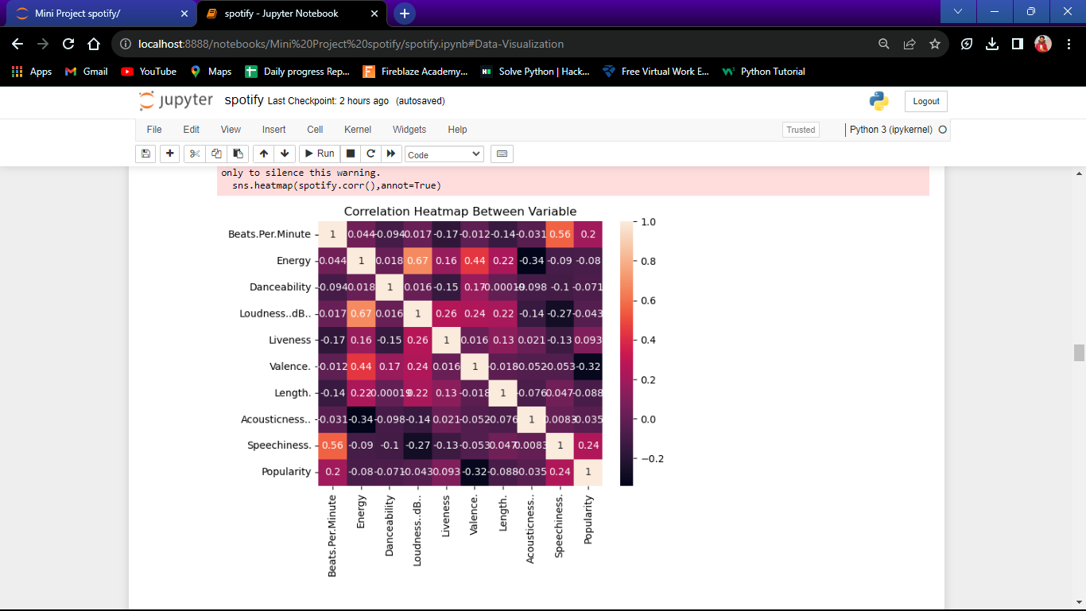
Correlation between variable
© All rights reserved by Fireblaze Technologies Pvt. Ltd.

Slide 6
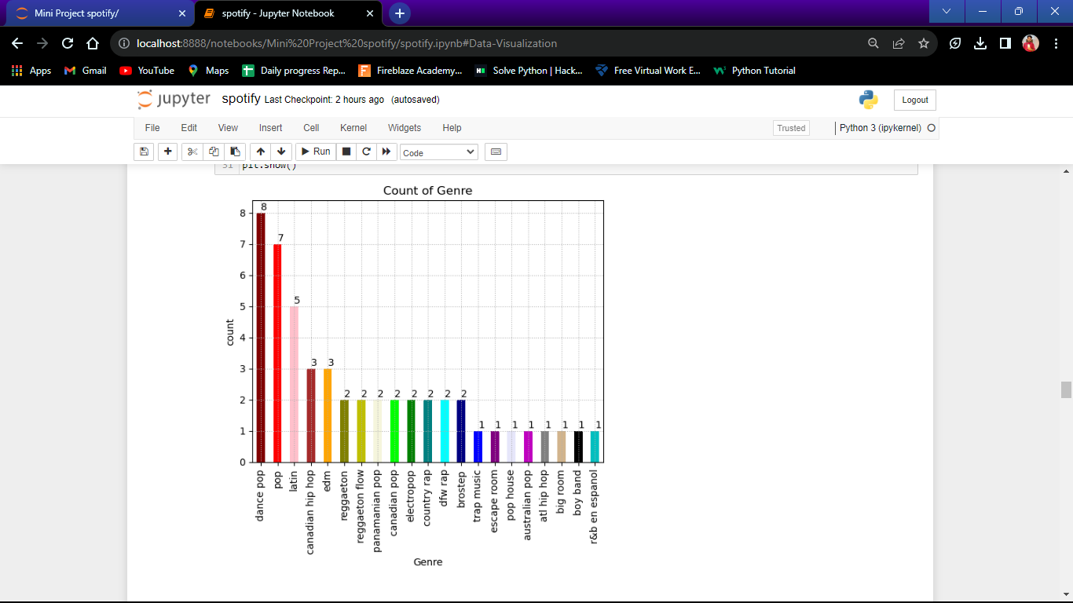
Count of genre
© All rights reserved by Fireblaze Technologies Pvt. Ltd.

Slide 7
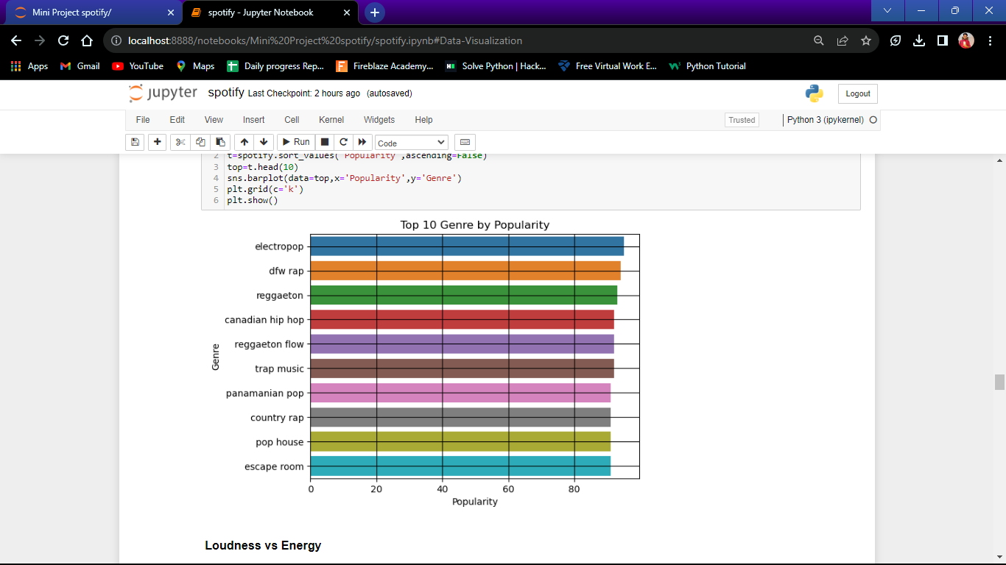
Top 10 genre by popularity
© All rights reserved by Fireblaze Technologies Pvt. Ltd.

Slide 8
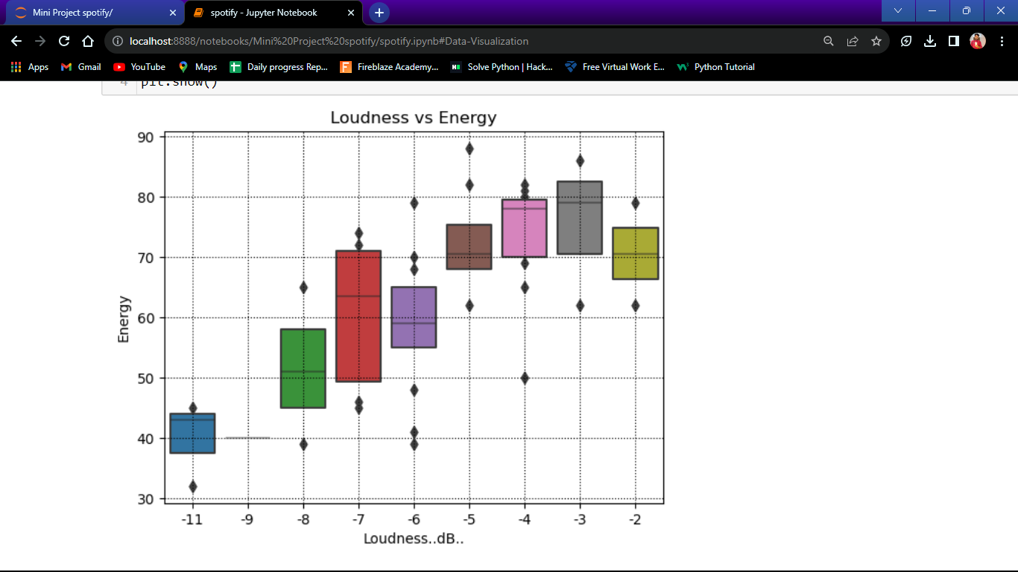
Loudness vs energy
© All rights reserved by Fireblaze Technologies Pvt. Ltd.

Slide 9
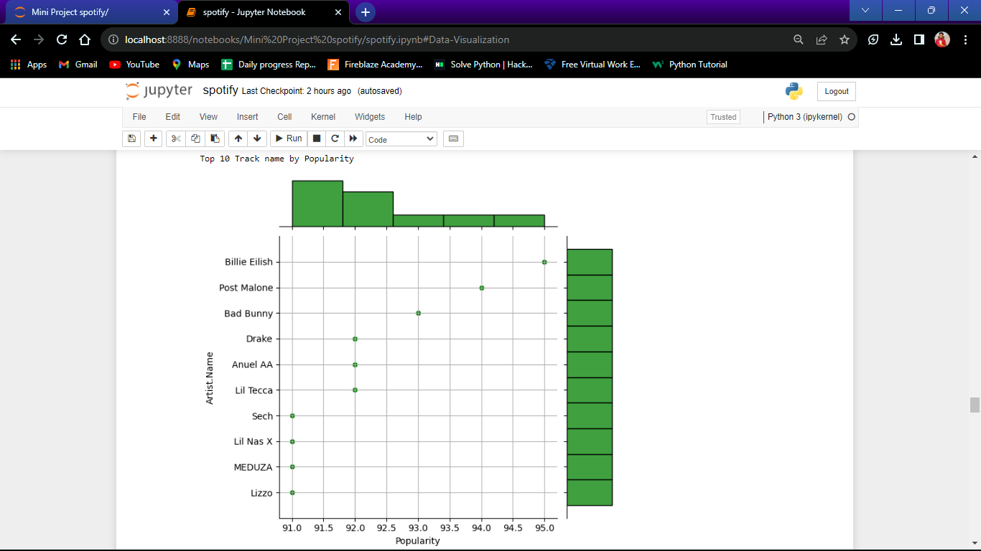
Top 10 Track name by Popularity
© All rights reserved by Fireblaze Technologies Pvt. Ltd.

Slide 10
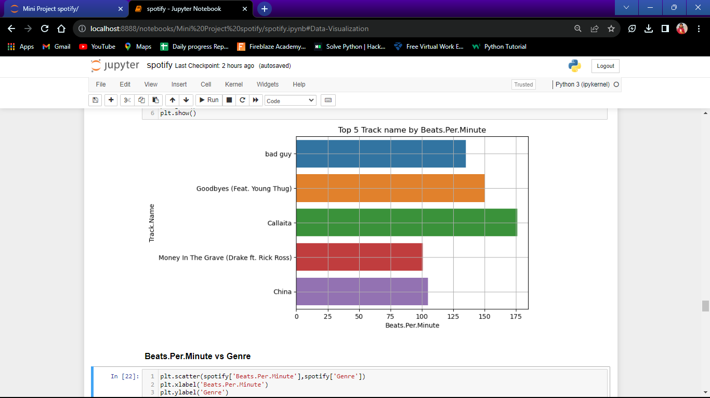
Top 5 Track name by Beats per minute
© All rights reserved by Fireblaze Technologies Pvt. Ltd.

Slide 11
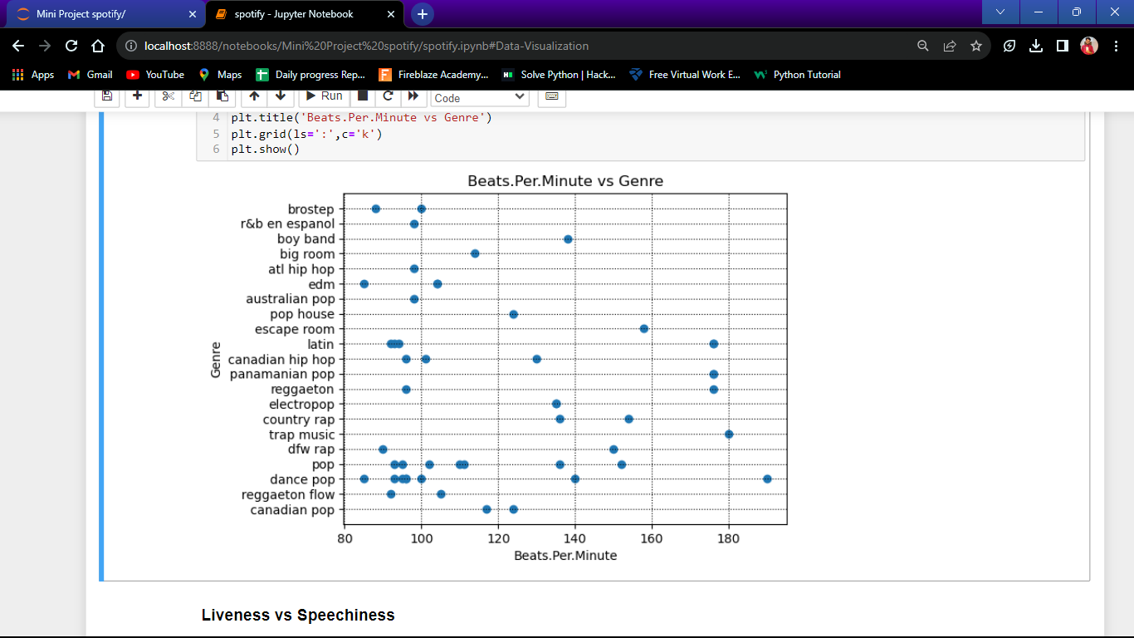
Beats per minute vs Genre
© All rights reserved by Fireblaze Technologies Pvt. Ltd.

Slide 12
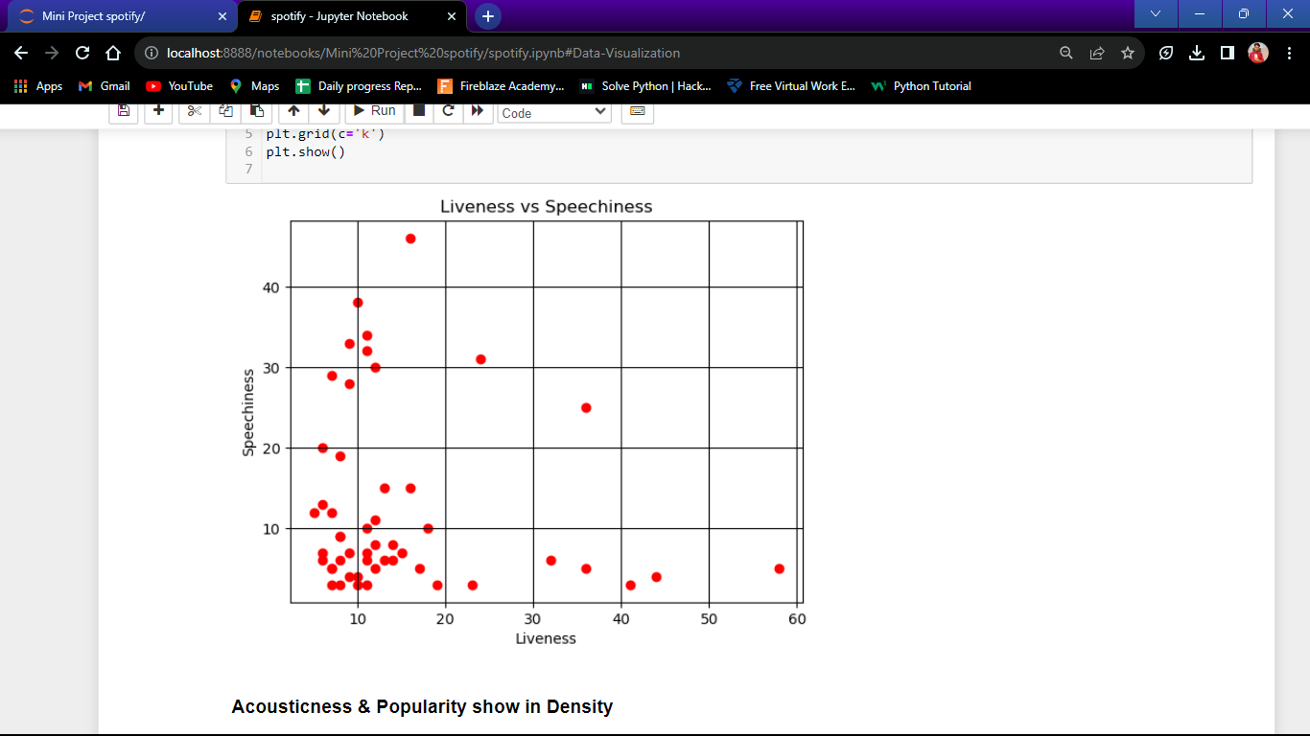
Liveness vs speechiness
© All rights reserved by Fireblaze Technologies Pvt. Ltd.

Slide 13
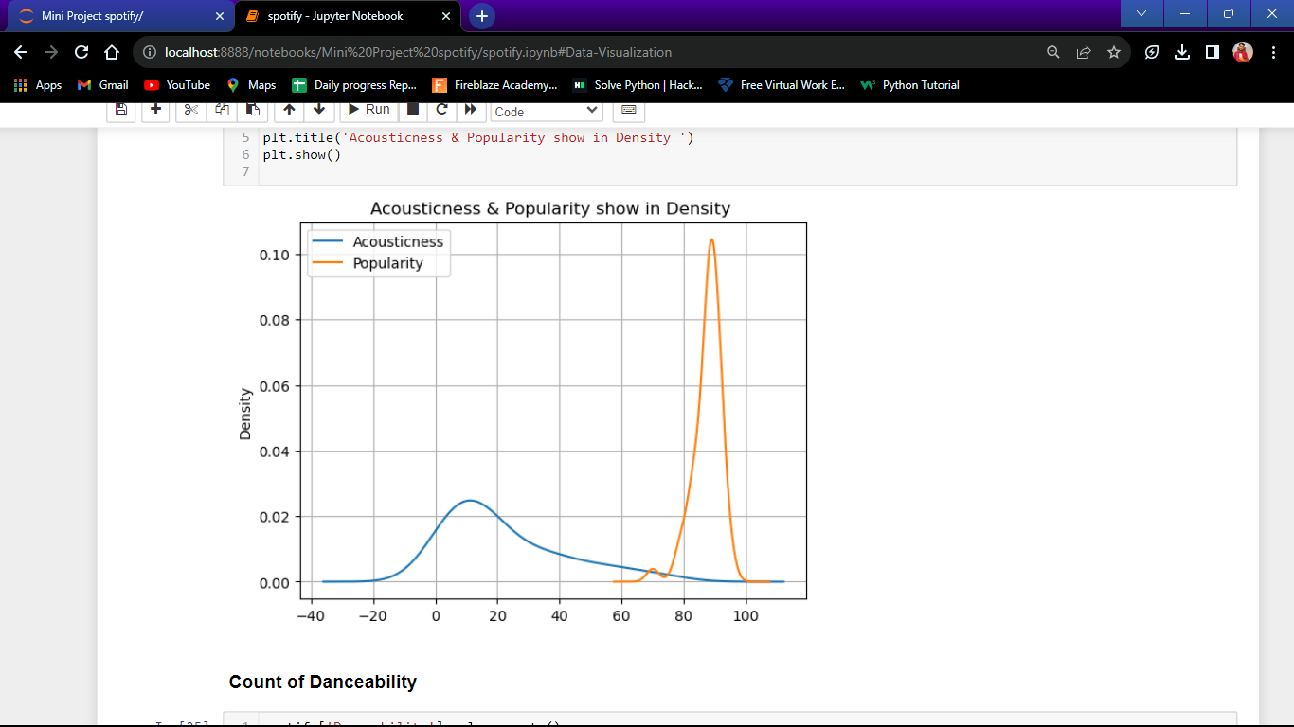
Acousticness & popularity show in density
© All rights reserved by Fireblaze Technologies Pvt. Ltd.

Slide 14
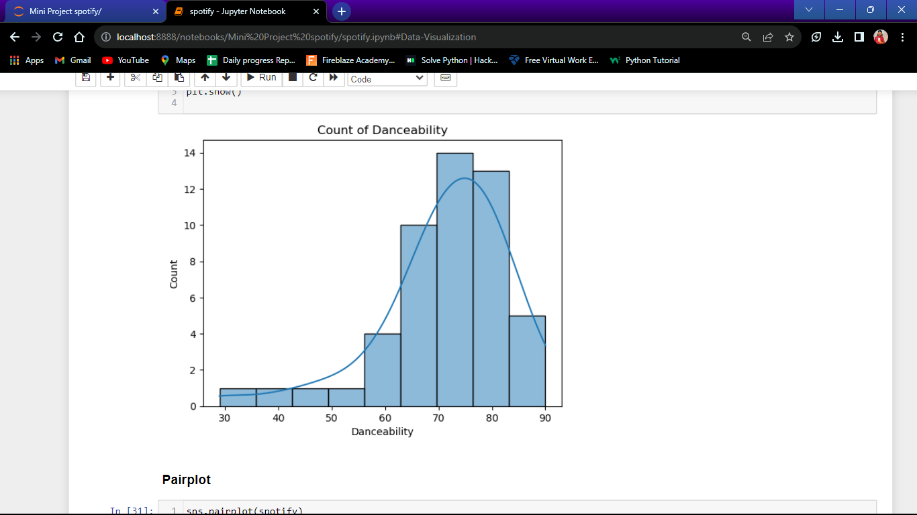
Count of Danceability
© All rights reserved by Fireblaze Technologies Pvt. Ltd.

Slide 15
Advantage
It is easy to use.
Spotify provides a tailored listening experience.
It is available on multiple platforms.
Spotify allows sharing music experiences.
It gives access to the massive music library.
© All rights reserved by Fireblaze Technologies Pvt. Ltd.

Slide 16
Disadvantage
It is expensive.
Spotify shows advertisements.
It offers low sound quality to free users.
Spotify requires an internet connection.
It is not universally available.
© All rights reserved by Fireblaze Technologies Pvt. Ltd.

Slide 17
Conclusion
Check out the graph above to see what music, artist genres are most popular, what tracks people listen to the most, and much more.
© All rights reserved by Fireblaze Technologies Pvt. Ltd.

Slide 18
Future Scope
This may include improving user recommendations, understanding music trends, and enhancing their personalized experiences. They may also use the data to better understand audience behavior and preferences in order to offer more targeted advertising and partnerships.
© All rights reserved by Fireblaze Technologies Pvt. Ltd.

Slide 19

.
© All rights reserved by Fireblaze Technologies Pvt. Ltd.

